Slide 1
ShanghaiTech University
EE 115B: Digital Circuits
Fall 2021
Lecture 12
Hengzhao Yang
November 11, 2021

Slide 2
VHDL
Introduction
Entity
Architecture
  Concurrent assignment statements

Slide 3
Introduction
VHDL
  VHSIC (Very High Speed Integrated Circuits) Hardware Description Language
FPGA
  Field Programmable Gate Array
IEEE standard 1076
  Original version adopted in 1987
  Revised in 1993, 2000, 2002, and 2008

Slide 4
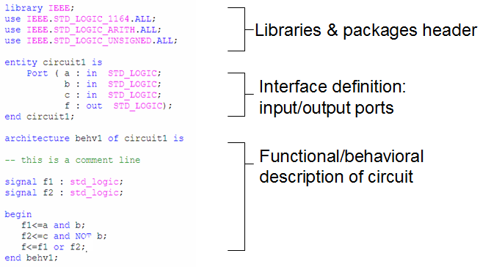
VHDL code: overview

Slide 5
VHDL code: overview
Basic constructs (building blocks)
  Entity
    Analogy: circuit symbol
    Define circuit interface
  Architecture
    Analogy: circuit diagram
    Define circuit functionality

Slide 6
VHDL code: sections
Use a library
Use packages to provide various data types
Define an entity: “circuit1”
Define the entity ports: name, mode, and data type

Slide 7
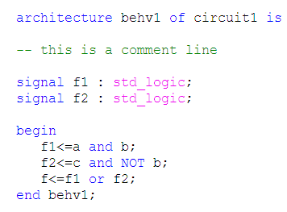
VHDL code: sections
Define an architecture “behv1” for entity “circuit1”
Comment starts with “--”
Declare internal signals: f1 and f2
Define circuit operation

Slide 8
VHDL
VHDL is NOT case sensitive
VHDL is concurrent
These statements are concurrent. They can be written in any order and the circuit operation is the same.

Slide 9
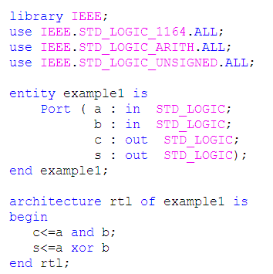
Example

Slide 10
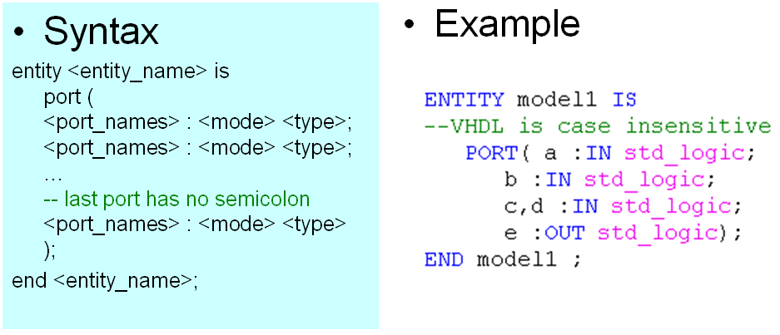
Entity

Slide 11
Entity: port mode
<mode>: indicate the port direction
  IN: port value may only be read
  OUT: port value may be updated
  BUFFER: port value may be both read and updated
  INOUT: port value may be both read and updated
BUFFER vs. INOUT (IEEE standard)
  Although signals of modes INOUT and BUFFER have the same characteristics with respect to whether they may be read or updated, a signal of mode INOUT may be updated by zero or more sources, whereas a signal of mode BUFFER must be updated by at most one source.

Slide 12
Entity: port type
<type>: indicate the signal type of the port
  bit: 0 or 1
  bit_vector: vector of bit values
  Boolean: TRUE or FALSE
  integer: integers
  std_logic: 9 values for signal value and strength
  std_logic_vector: vector of std_logic values
Part of VHDL standard
Require IEEE package

Slide 13
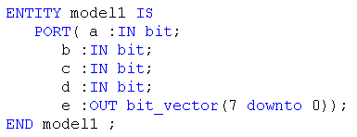
Entity: port type
Standard ‘bit’
  ‘0’: binary zero
  ‘1’: binary one
Example

Slide 14
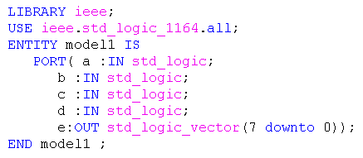
Entity: port type
IEEE ‘std_logic’ (package: ‘std_logic_1164’)
  ‘0’: binary zero
  ‘1’: binary one
  ‘Z’: high impedance
  ‘-’: don’t care
  ‘U’: uninitialized
  ‘X’: unknown
  ‘W’: weak unknown
  ‘L’: weak zero
  ‘H’: weak one

Slide 15
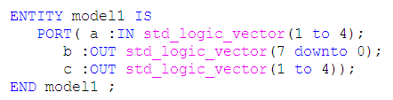
Entity: port type
bit_vector: array of bit objects
std_logic_vector: array of std_logic objects
Example
Results
  a <= “0011”: a(1)=0, a(2)=0, a(3)=1, a(4)=1
  b <= “10011000”: b(7)=1, b(6)=0, …, b(0)=0
  c <= “1011”: c(1)=1, c(2)=0, c(3)=1, c(4)=1

Slide 16
Architecture
An architecture represents one possible implementation of its associated entity
  architecture declarations: define internal signals, components, etc. to be used in architecture body
  architecture body: define implementation details of input/output relationship
Multiple architectures can exist for an entity

Slide 17
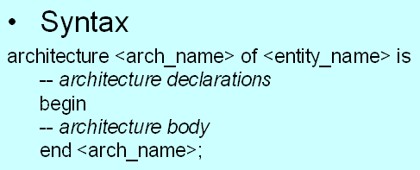
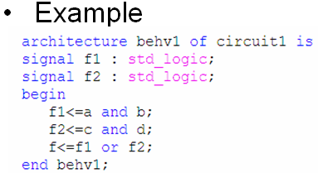
Architecture: overview

Slide 18
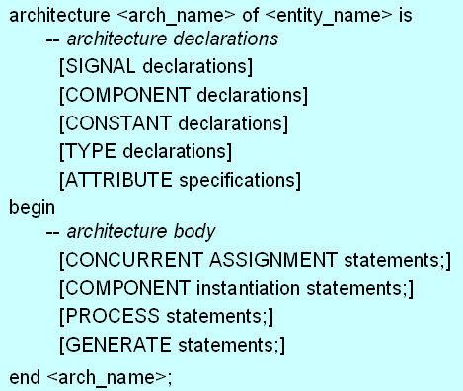
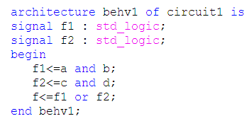
Architecture: general form
CONCURRENT ASSIGNMENT statements
SIGNAL declarations

Slide 19
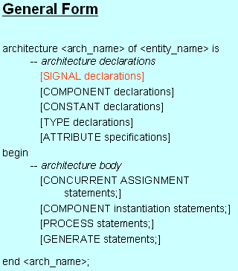
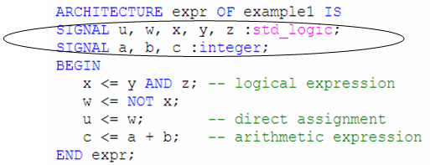
Architecture declarations: signal
For internal signals within the architecture
Syntax: signal <signal_name> : <type>

Slide 20
Architecture body
Concurrent assignment statements
  Direct signal assignment
  Selected signal assignment
  Conditional signal assignment
  Component statement
  Generate statement
Sequential assignment statements
  Process statement (IF, CASE, FOR, …)

Slide 21
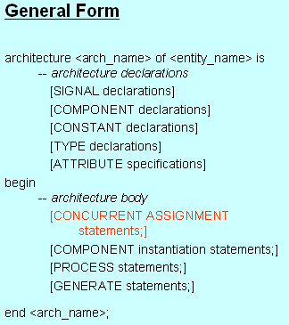
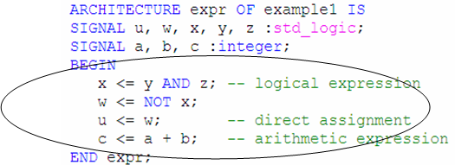
Concurrent: direct signal assignment
Syntax: <target> <= <expression>
  <target> can be an internal signal or an output port
  <expression> operates on internal signals and/or input ports

Slide 22
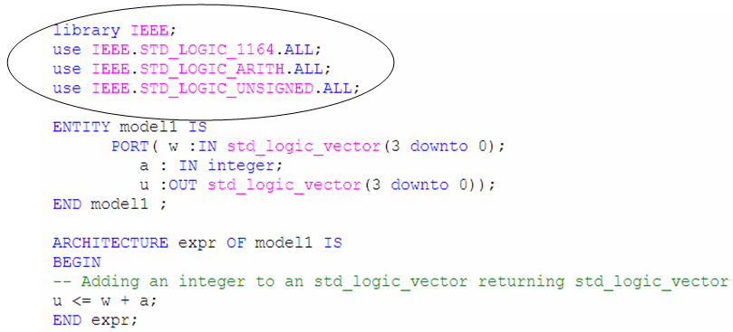
Operators and expressions
VHDL standard: arithmetic and logical operators are defined for standard integer, Boolean, bit, bit_vector types.
Logical operators using std_logic and std_logic_vector types require ‘IEEE std_logic_1164’ package
Arithmetic operators using std_logic and std_logic_vector types require ‘IEEE std_logic_unsigned’ and ‘IEEE std_logic_arith’ packages

Slide 23
Operators
Order of precedence
 | Class | Operator
Highest Lowest | Miscellaneous | NOT, abs, ** (exponentiation)
 | Multiplying | *, /, mod (modulus), rem (remainder)
 | Sign | +, -
 | Adding | +, -, & (concatenation)
 | Shift | sll, srl, sla, sra, rol, ror
 | Relational | =, /=, <, <=, >, >=
 | Logical | AND, OR, NAND, NOR, XOR, XNOR

Slide 24
Operators
Order of precedence
  Operators of highest precedence are evaluated first
  Deepest nested parentheses are evaluated first
  Operators of the same precedence are evaluated from left to right
  Logical operators have same precedence
Use parentheses to ensure correct expressions
Example: SOP form
    f <= (x1 and x2) or (x3 and x4)

